Slide 1
Think before you Toss Ways to reduce your towns solid waste. PAYT program help reduce solid waste 25 to 35 percent Food Waste Diversion Composting Program Create a “one stop shop” recycling model
Linda Cernik

Slide 2
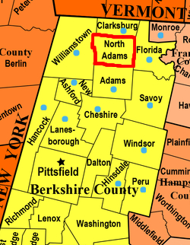
History of Town ABC within Western Mass
The Western Mass Region 100 towns pooling resources
Plan to reduce tonnage of Solid Waste per household.
Towns to offer PAYT Program
Food Waste diversion programs
Offer additional recycling services “One Stop Shop”
Think before you Toss

Slide 3
Introduction
Rising collection and disposal costs of Solid Waste
Think before you toss, can this be recycled / reuse?
It’s likely residents are throwing away more each year –pointing to the need not only to offer additonal recycling but also for getting residents to generate less waste in the first place.
Implement a “Pay –as-you-throw “ (PAYT)
Food Waste Diversion Program
Offer additional reycling Services Model “One Stop Shop” such as Textile, book, Scrap , Bulky items, Universal waste and more.

Slide 4
What is pay-as-you-throw?
PAYT Programs , also know as unit-based pricing , providing a direct economic incentive for your residents to reduce the amount of solid waste generated.
Under PAYT , households are charged for waste collection based on the amount they throw away. As a result, in residents are motivated to increase recycling but also to think about ways to generate less waste.
PAYT Programs models under volume-based programs , residents are charged a fee for each bag or purchase bag tags and affix them to their own bags.

Slide 5
What are the benefits of a pay-as-you-throw
However, it is structured , PAYT has the potential to improve Municipal Solid Waste programs in several important ways.
Significant economic benefits/ grant incentives to the Towns to implement
Incentive to generate less waste , communties with PAYT programs have reported reduction in waste from 25 to 35 percent on average.
This can lead to lower disposal costs and increase your towns recycling programs.
In addition , this program can be designed to cover the cost of not only waste collection and disposal. Can also cover community outreach and special collections expand recycling services.

Slide 6
Outreach and Education conversion to PAYT Program
Educating your residents is key to success of a PAYT Program
Offer information sessions to the public.
Create an informational handout to give out one site
Think before you Toss, it’s likley this will increase your recycling Tonnage and decrease Municipal Solid Waste.
Compare current costs v.s. PAYT costs savings and through recycling and how this can benefit the enviroment as well.
It’s opportunity for residents to take controls of costs for disposal fees by lowering waste.

Slide 7
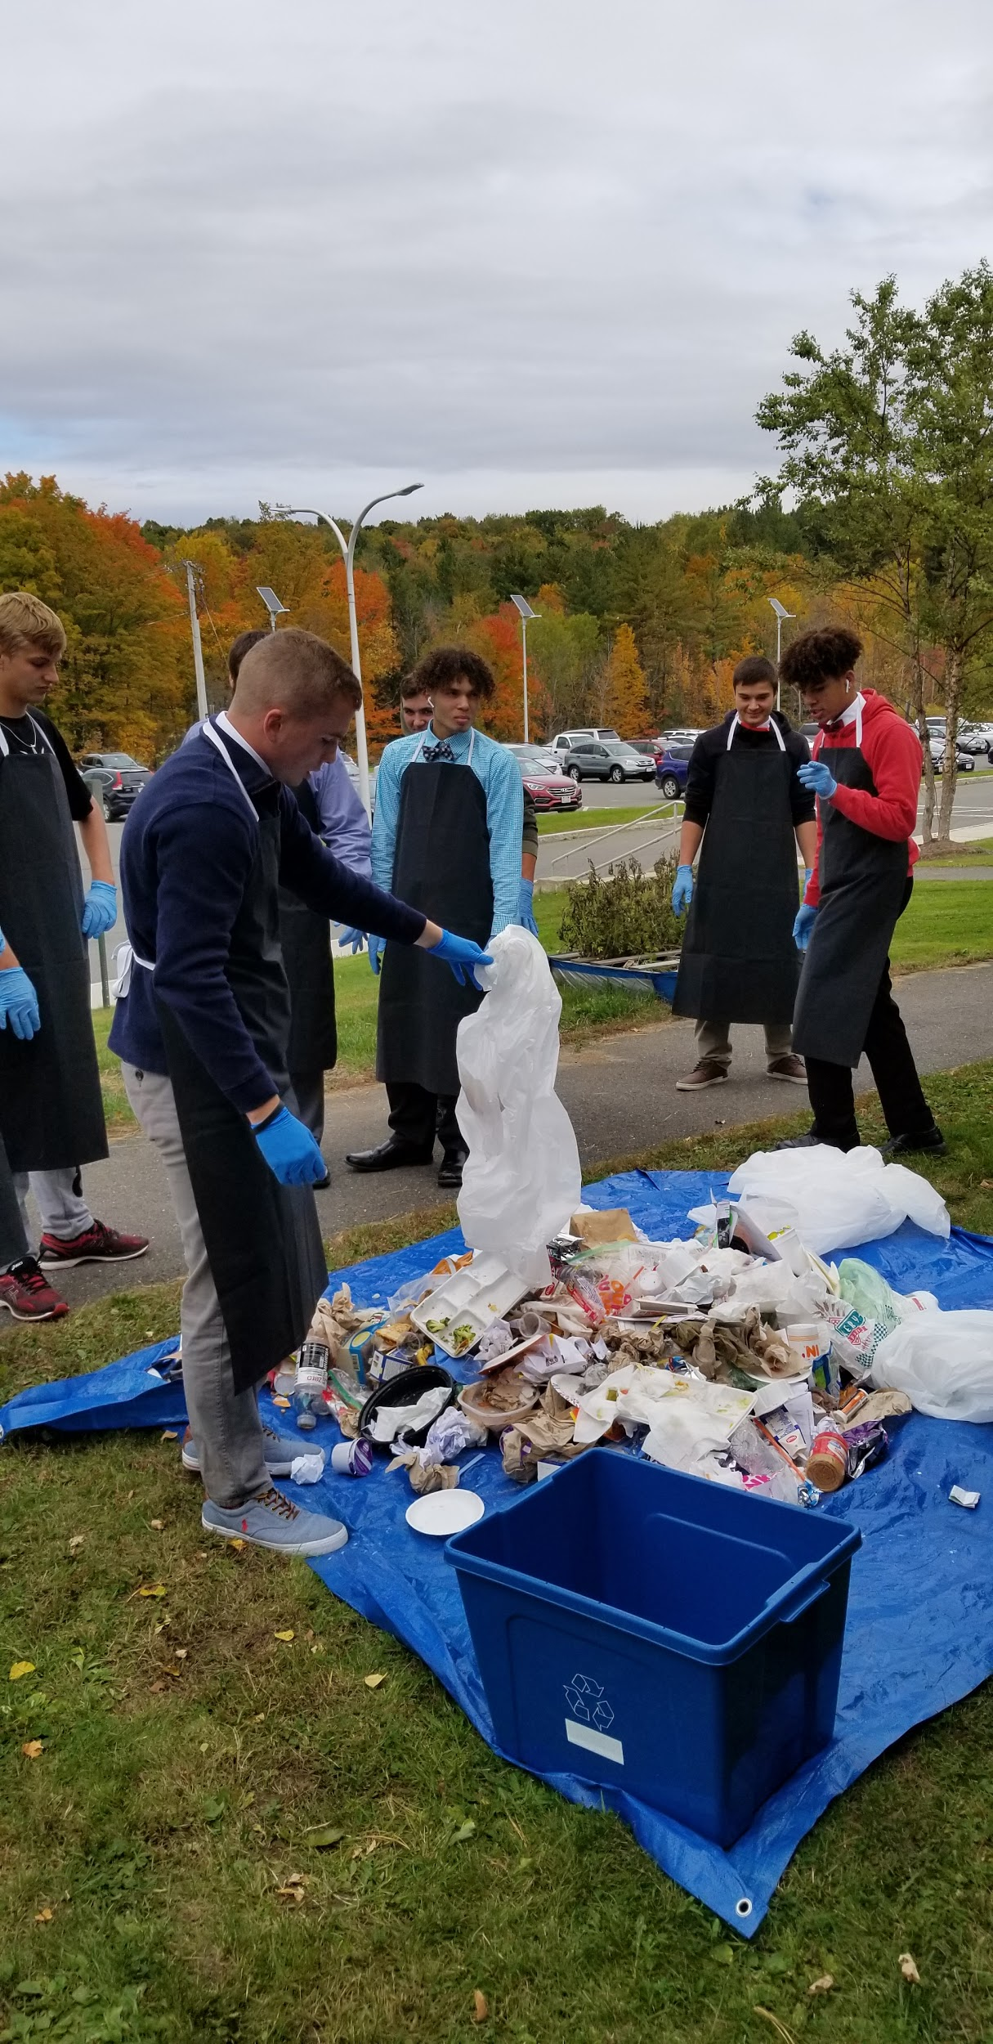
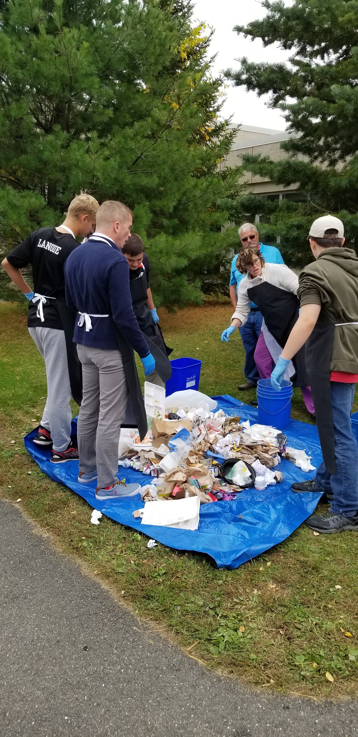
Educational Outreach in Food Waste Diversion Programs
Coordinates and promotes recycling/composting education and events in schools and Community.
Helps build and sustain a zero-waste and anti-plastic culture without forcing change through regulations

Slide 8
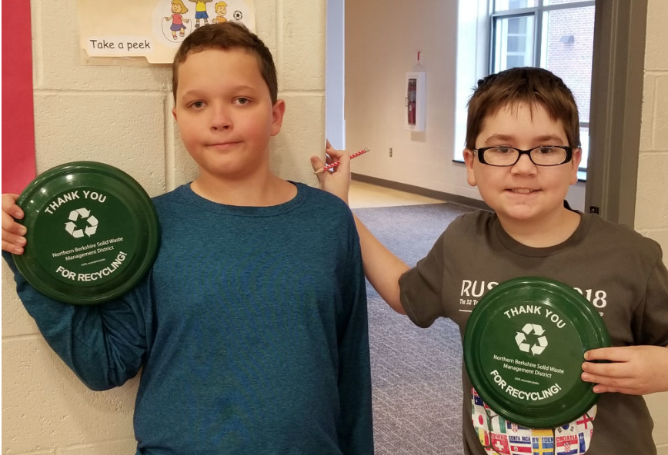
Community Outreach recycling
Community events and outreach help increase awareness and knowledge of recycling/composting for the broader community(zero waste event).
Promote Recyclesmart.ma App.
Spreads word of transfer station cost savings
Promote Food Waste diversion programs to help reduce Solid Waste Tonnage. Start with a pilot project, working with local stakeholders.
Work closely with your Towns Departments such as Board Of Health and DPW.

Slide 9
Grant Funding Opportunities
PAYT gains your town 4 points towards Recycling Dividends Award
Would make it easier/free for the TS to get offer one stop center
to expand recycling services(gaining additional Points for RDP)
Brush, food waste diversion pilot project
Textile recovery program (could save hundreds of dollars per year)
School programs, Green Team
Linda’s success growing grant funding:
3 towns earned $500 “Small Initiative” grants, and 10 others earned Recycling Dividends grants
$45,8000 awarded to NBSWMD in total in 2020 , 13 towns within the district
Grants can be allocated to implement PAYT programs, Special collections days, purchase Home Composting Bins, offset town’s recycling expenses and more. All of which help reduce prohibited items from entering the waste stream, in turn reduse your solid waste tonnage.
Notes:
(Need to mention that this grant funding increased by 48.5% last year!)

Slide 10
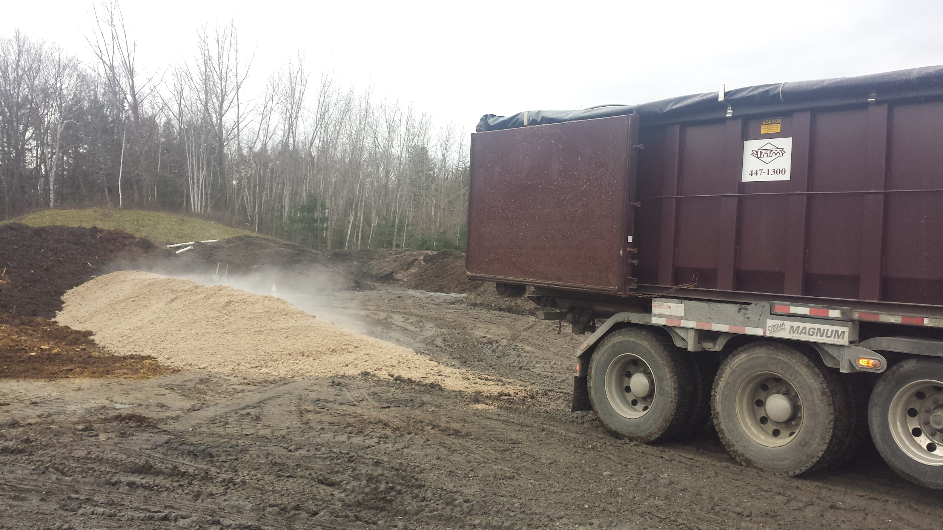
Composting Initiatives
Subsidized equipment for home composting
Alliances with community organizations
Future:
Transfer station composting at local farms for residential and commercial use
Offer pilot projects to engage residents
Create compost for your garden or community gardens , share program.
Residents to become environmental stewards.

Slide 11
State Composting Regulations
Food waste composting regulations expected to directly impact small businesses and households.
Food Waste Diversion Program not only reduce Solid waste but is a good re-use recycling program.
Offering a Pilot project to residents
for a buy in program, working with
local farmers and contracted
hauler.
Notes:
Increased enforcement of a regulation on brush composting caused costs to increase

Slide 12
Conclusion

Slide 13
Benefits for Everyone
Together we are making a difference
Benefits for the Transfer Station
Educational Outreach, MassDEP Green Team
Community Outreach, Why Recycle?
In Turn helps reduce Solid Waste tonnage , increase reuse and recycling.
Creates re-use product “black gold” .
Grant funding opportunities to increase with PAYT and Food Waste Diversion, and leaf and brush compost, expanded recycling services.
Reduces Muncipal Solid Waste tonnage
Offering one stop shop(possible Charm) expansion of recycling services
Less chance of items entering the waste stream that are prohibited through MassDEP waste ban compliance.
Educate our residents as envirmomental stewards.

Slide 14
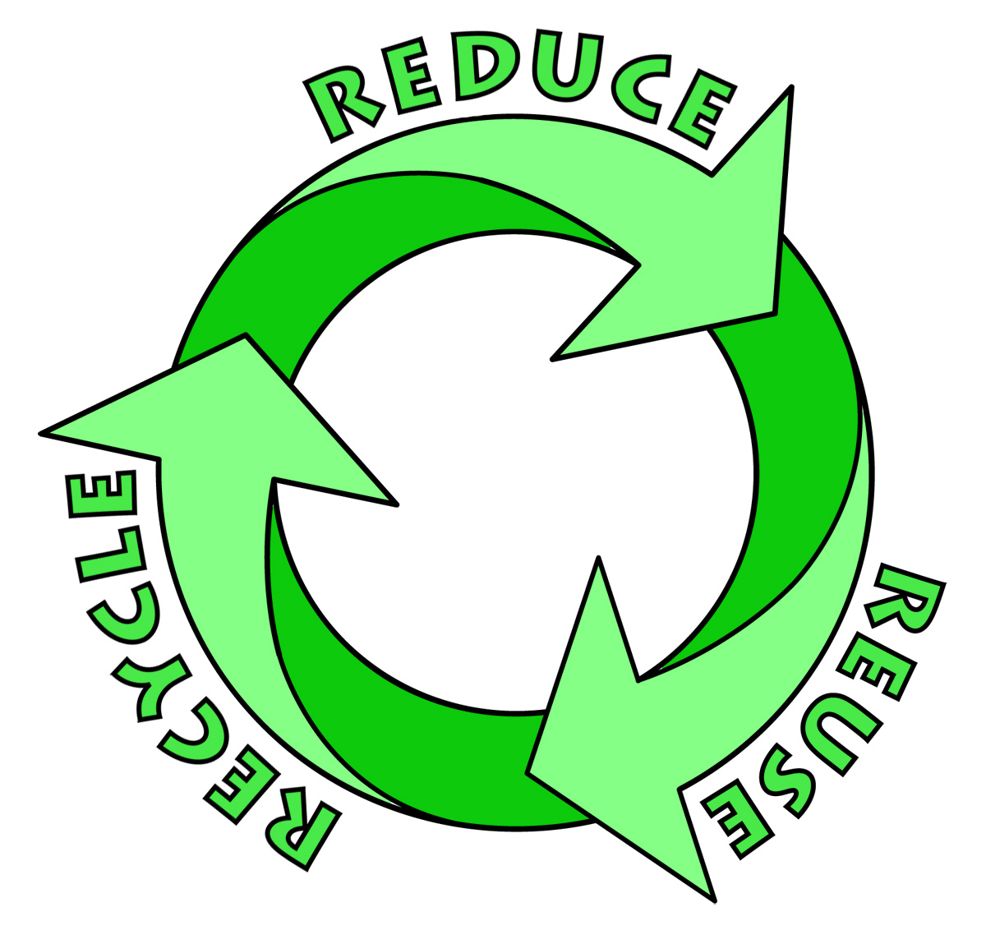
Thank you!

